Slide 1
GYM MANAGEMENT SYSTEM

Slide 2
TABLE DESIGN TABLE NAME:EMPLOYEE
FIELD | DATA TYPE | SIZE | CONSTRAINT
employee id | Int | 10 | Primary key
First name | Varchar | 20 | Not null
Last name | Varchar | 10 | Not null
Mobile | Int | 10 | Not null
Email | Varchar | 20 | Not null
Age | Int | 10 | Not null
Gender | Varchar | 5 | Not null
Address | Varchar | 30 | Not null

Slide 3
TABLE NAME:MEMBER
FIELD | DATA TYPE | SIZE | CONSTRAINT
Member id | Int | 10 | Primary key
First name | Varchar | 20 | Not null
Last name | Varchar | 10 | Not null
Mobile | Int | 10 | Not null
Email | Varchar | 20 | Not null
Age | Int | 10 | Not null
Gender | Varchar | 5 | Not null
Height | Int | 5 | Not null
Weight | Int | 5 | Not null
Address | Varchar | 30 | Not null

Slide 4
TABLE NAME:INOUT/OUTPUT
FIELD | DATA TYPE | SIZE | CONSTRAINT
In out id | Int | 10 | Primary key
Member id | Int | 10 | Foreign key
Punch in | Date | 10 | Not null
Punch out | Date | 10 | Not null
date | Date | 10 | Not null

Slide 5
TABLE NAME:MATERIAL
FIELD | DATA TYPE | SIZE | CONSTRAINT
Material id | Int | 10 | Primary key
Material name | Varchar | 30 | Not null
Quantity | Int | 6 | Not null
amount | Int | 5 | Not null

Slide 6
TABLE NAME:SERVICE
FIELD | DATA TYPE | SIZE | CONSTRAINT
Service id | Int | 10 | Primary key
Material name | Varchar | 20 | Not null
Provider | Varchar | 20 | Not null
Amount | Int | 5 | Not null
Issue | Varchar | 30 | Not null
date | Date | 10 | Not null

Slide 7
TABLE NAME:ADMIN
FIELD | DATA TYPE | SIZE | CONSTRAINT
admin id | Int | 10 | Primary key
Admin name | Varchar | 20 | Not null
Admin mobile | Int | 10 | Not null
Username | Varchar | 20 | Not null
Password | Varchar | 20 | Not null
address | Varchar | 30 | Not null

Slide 8
TABLE NAME:HEALTH
FIELD | DATA TYPE | SIZE | CONSTRAINT
Health id | Int | 10 | Primary key
Health title | Varchar | 20 | Not null
Description | Varchar | 30 | Not null
date | Date | 10 | Not null

Slide 9
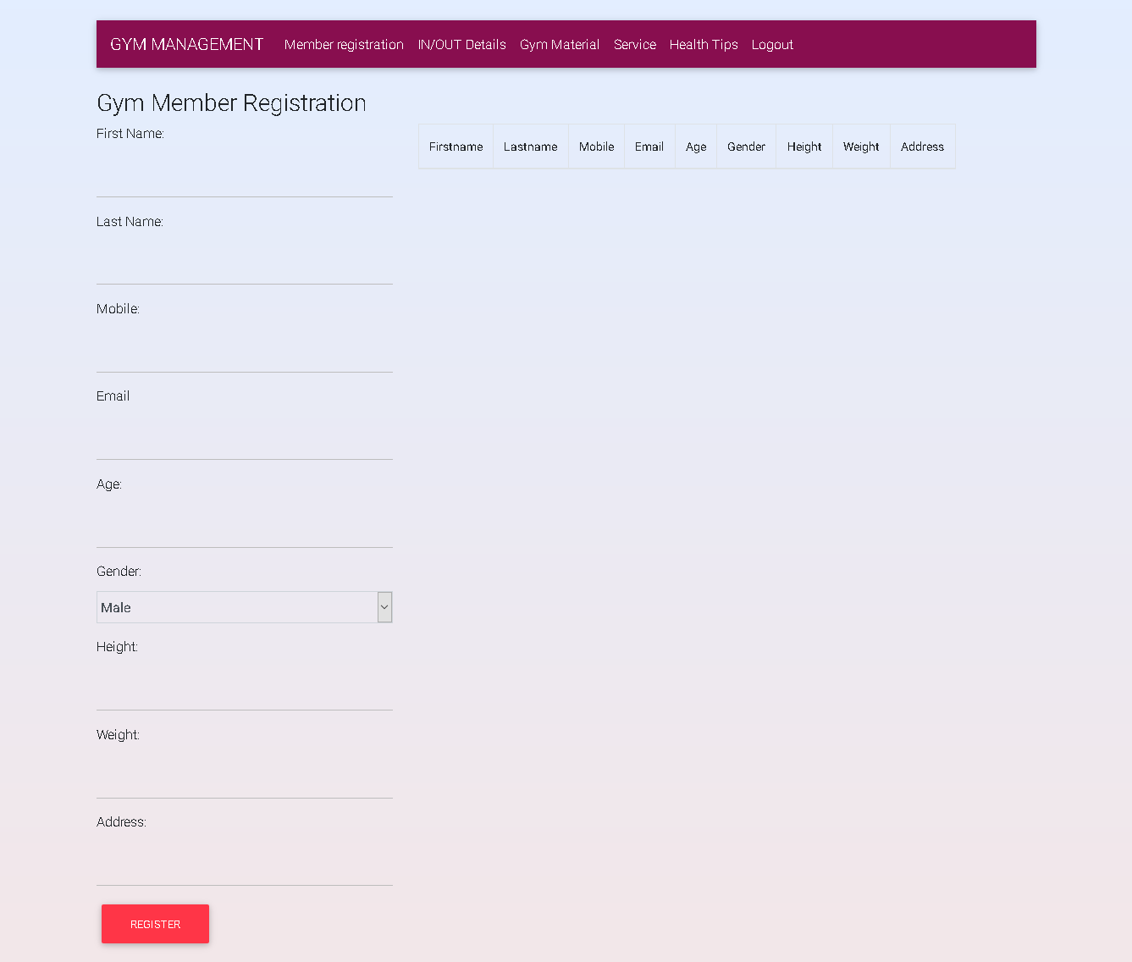

Slide 10
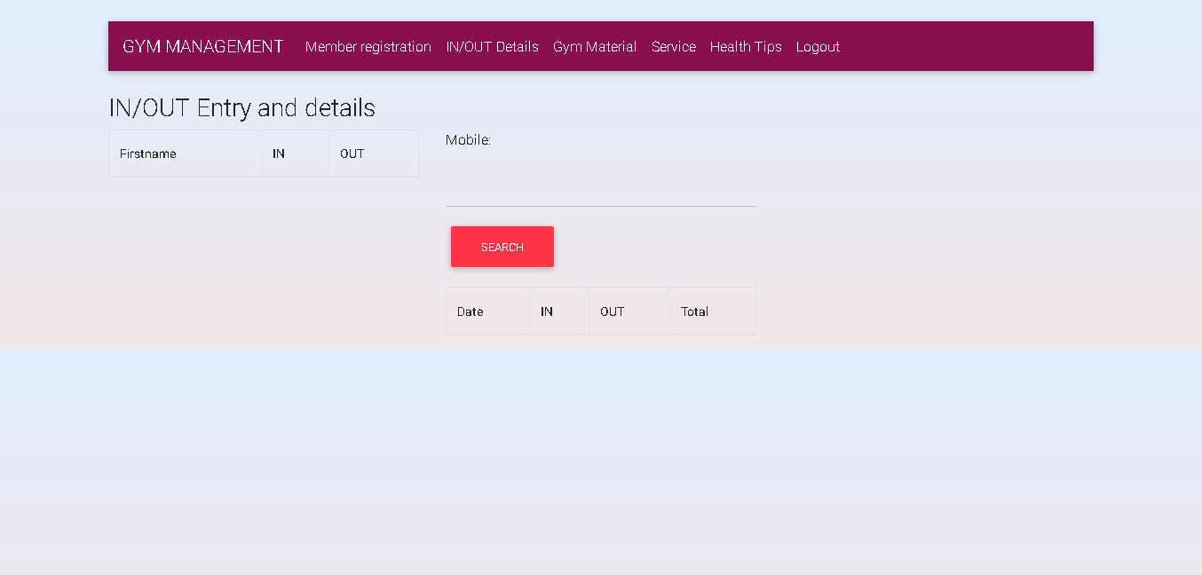

Slide 11
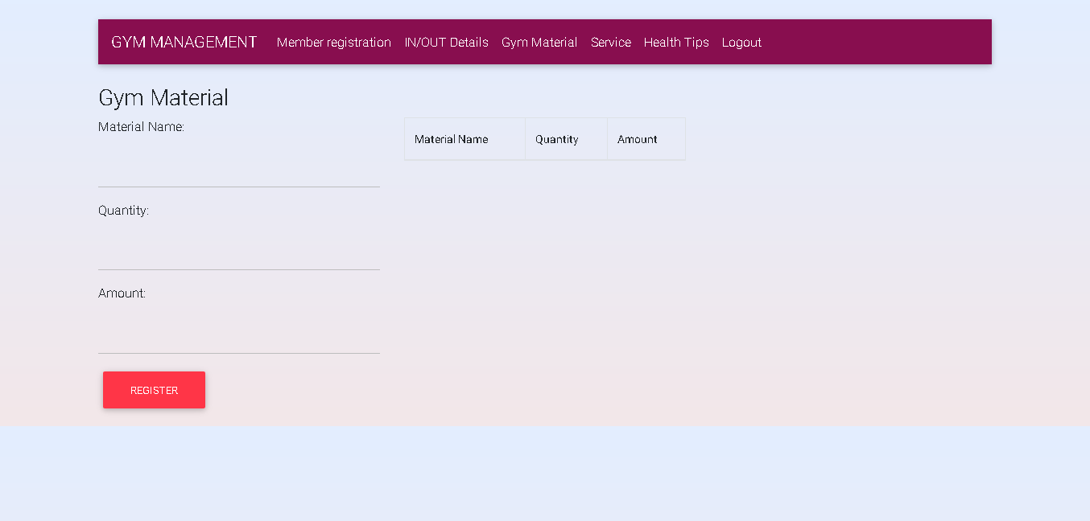

Slide 12
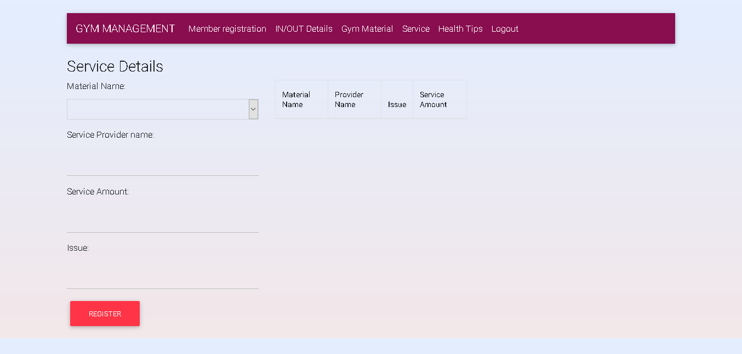

Slide 13
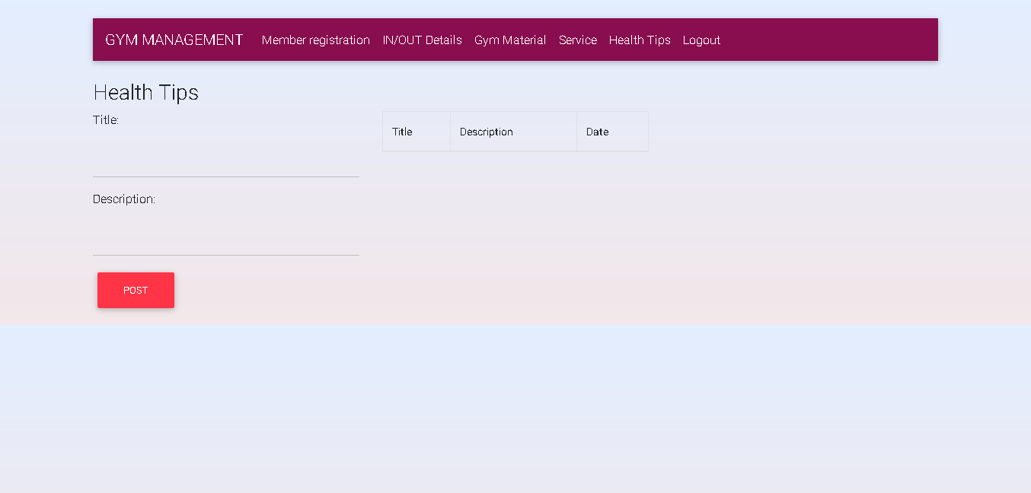

Slide 14
THANK YOU

